Slide 1
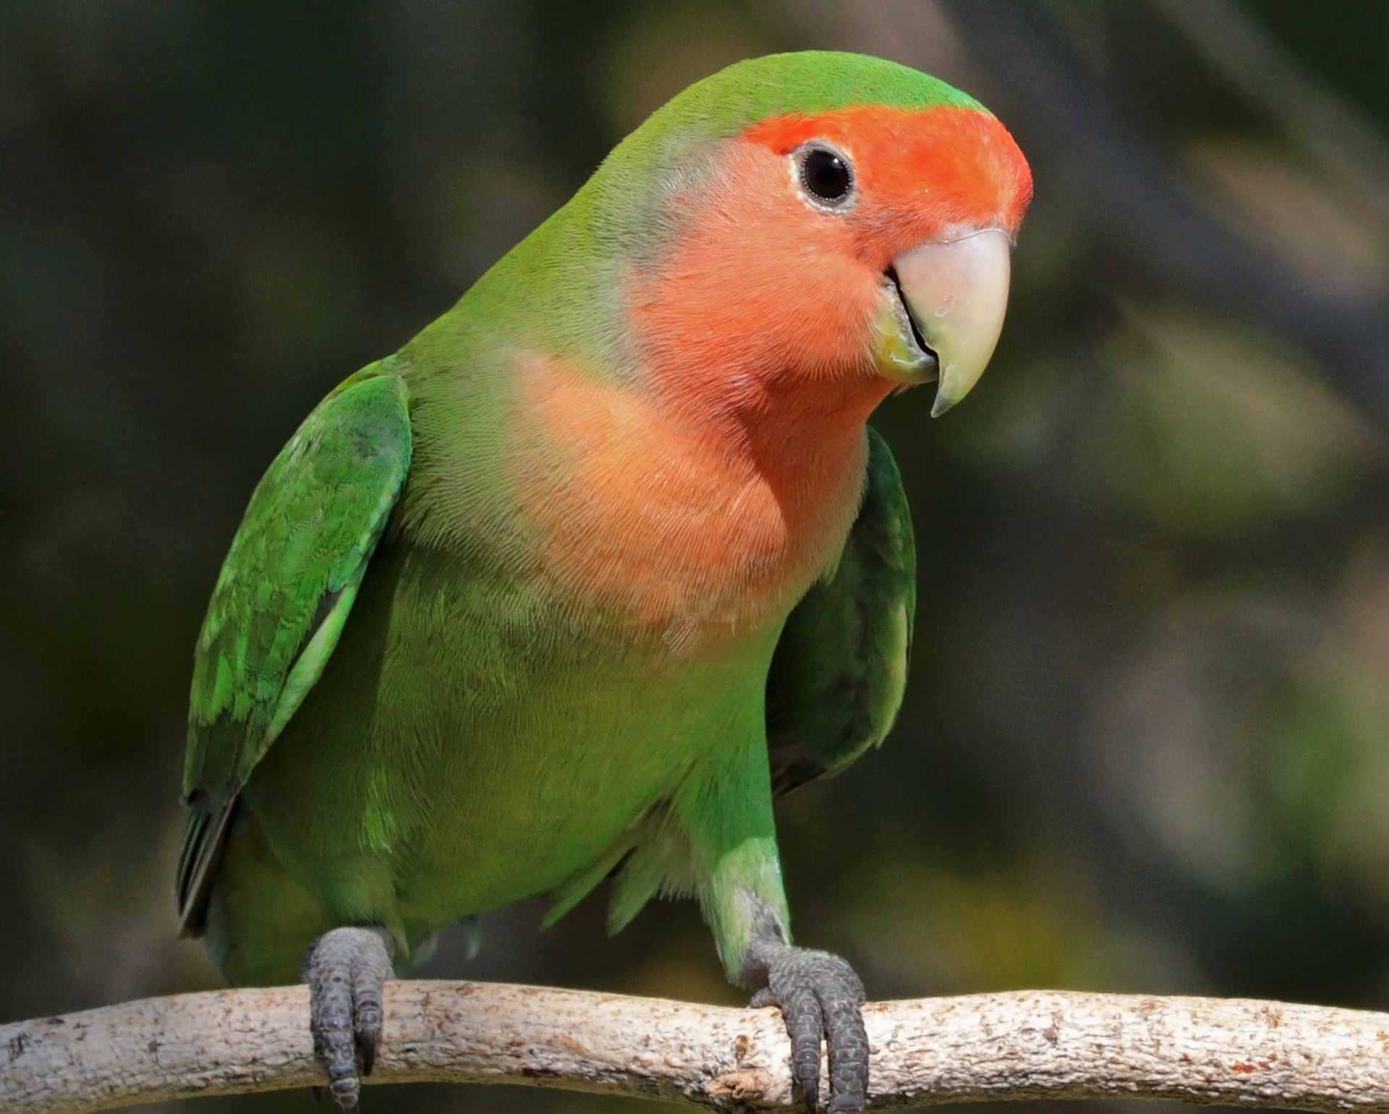
BIRDIE

Slide 2
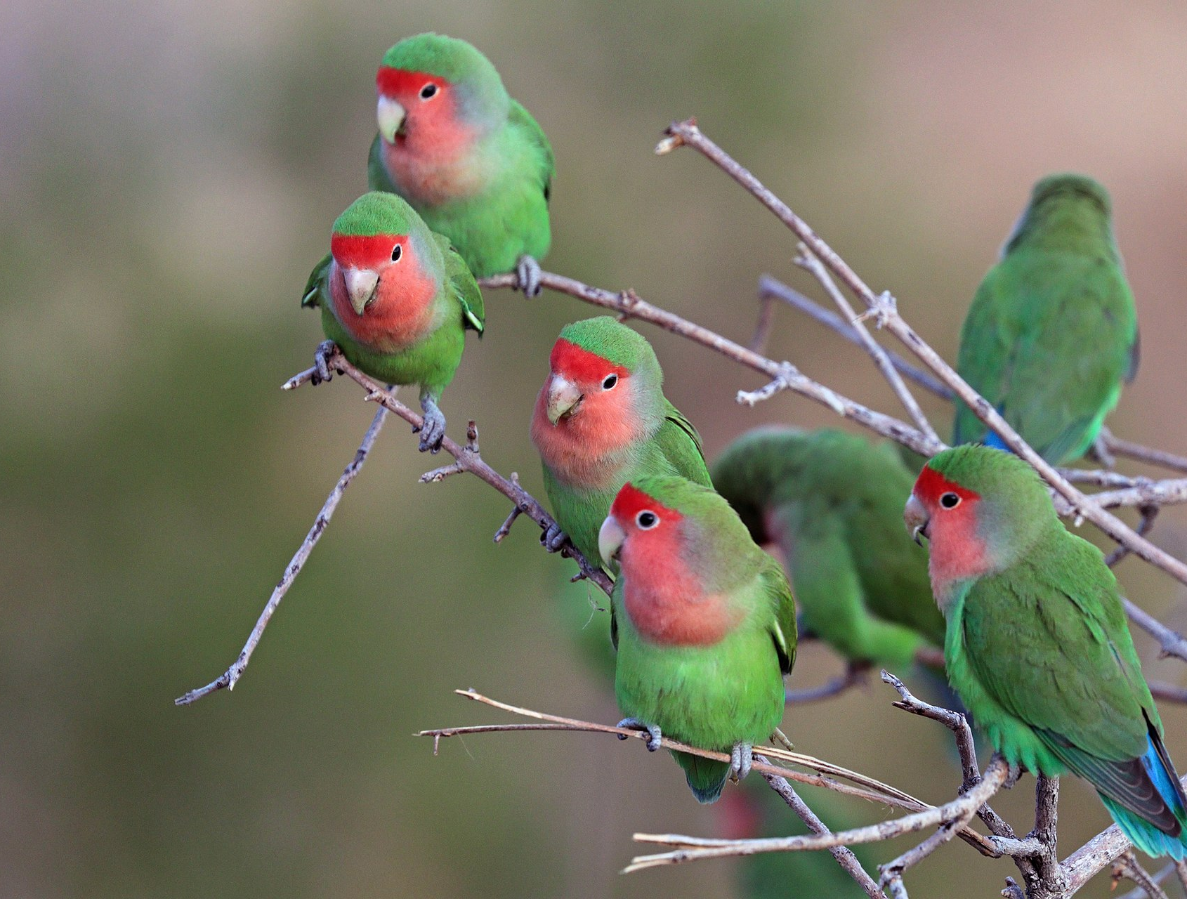
FEATURES
BIRD DATABASE
GREEN PEACH FACED

Slide 3
BIRD COLOUR CALCULATOR

Slide 4
BIRD JOURNAL
PEACH FACED LUTINO

Slide 5
ADDITIONAL FEATURES
REMOVES INDIVIDUAL DATA ENTRY FOR BIRD DATABASE AND BIRD JOURNAL
SAVES DATA TO A FILE

Slide 6
“HAPPY BIRDING.”
–WILSON

